Slide 1
Discrete Mathematics
Chapter 9
Graphs

Slide 2
Introduction to Graphs
A graph G = (V, E) consists of V, a nonempty set of vertices (or nodes) and E, a set of, edges.
Each edge has either one or two vertices associated with it, called its endpoints. An edge is said to connect its endpoints.

Slide 3
Graphs
G = (V, E) where
V = {v₁, v₂, …., v₇}
E = {{v₁, v₂}, {v₂, v₃},
{v₃, v₄},{v₄, v₅}, {v₅, v₆},
{v₆, v₃},{v₂, v₇}, {v₁, v₇}}
v₁
v₄
v₂
v₃
v₅
v₇
v₆

Slide 4
Directed Graph (Digraph)
A directed graph (or digraph) (V, E) consists of a nonempty set of vertices V and a set of directed edges (or arcs) E.
Each directed edge is associated with an ordered pair of vertices. The directed edge associated with the ordered pair (u, v) is said to start at u and end at v.

Slide 5
Directed Graphs
G = (V, E) where
V = {v₁, v₂, …., v₇}
E = {(v₁, v₂), (v₂, v₃),
(v₃, v₄), (v₄, v₅), (v₅, v₆), (v₆, v₃),(v₂, v₇), (v₁, v₇)}
v₁
v₄
v₂
v₃
v₅
v₇
v₆

Slide 6
Structure of a Graph
The terminology used to describe graphs may vary but three key questions can help us understand the structure of a graph:
Are the edges of the graph undirected or directed (or both)?
If the graph is undirected, are multiple edges present that connect the same pair of vertices?
Are loops present?

Slide 7
Graph Terminology
Type | Edge | Multiple edges allowed? | Loops allowed?
Simple graph | Undirected | No | No
Multigraph | Undirected | Yes | No
Pseudograph | Undirected | Yes | Yes
Simple directed graph | Directed | No | No
Directed multigraph | Directed | Yes | Yes
Mixed graph | Directed and Undirected | Yes | Yes

Slide 8
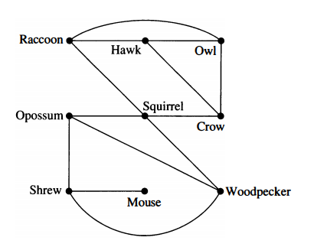
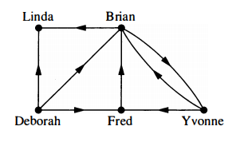
Graph Models
Niche Overlap Graphs in Ecology
Influence Graph

Slide 9
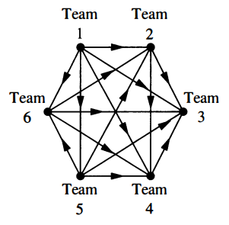
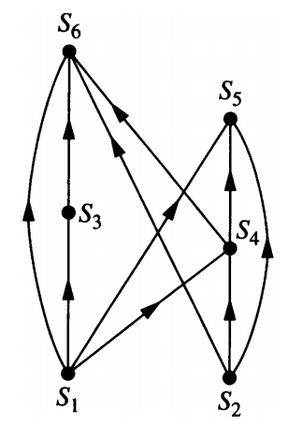
Graph Models
Round-Robin Tournament
Precedence Graph

Slide 10
Handshaking Theorem
Let G = (V, E) be an undirected graph with e edges. Then
Example: How many edges are there in a graph with 10 vertices each of degree six?

Slide 11
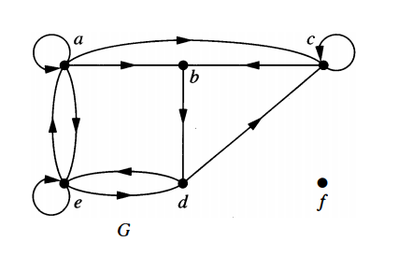
Theorem 3
Let G = (V, E) be a graph with directed edges. Then

Slide 12
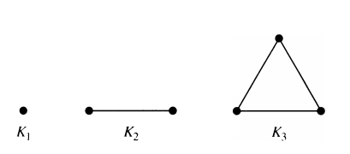
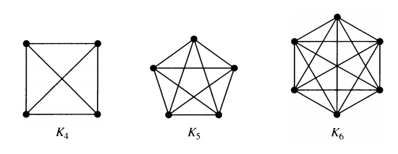
Special Simple Graphs
Complete Graphs: the complete graph of n vertices, denoted by K_{n} , is the simple graph that contains exactly one edge between each pair of distinct vertices.

Slide 13
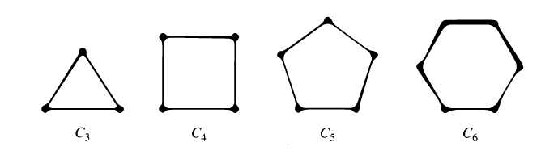
Special Simple Graphs
Cycles: The cycle C_{n}, n≥3, consists of n vertices v₁, v₂,…,v_{n} and egdes {v₁, v₂}, {v₂, v₃},…,{v_{n-1}, v_{n}}, {v_{n}, v₁}

Slide 14
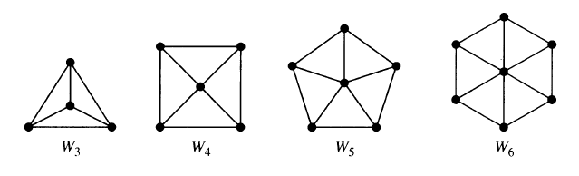
Special Simple Graphs
Wheels: We obtain the wheel W_{n} when we add an additional vertex to the cycle C_{n}, for n≥3 and connect this new vertex to each of the n vertices in C_{n}, by new edges.

Slide 15
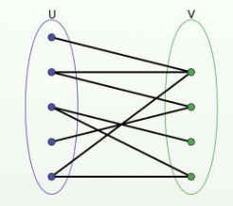
Bipartite Graph
A simple graph G is called bipartite if its vertex V can be partitioned into two disjoint sets, V₁ and V₂ such that every edge in the graph connects a vertex in V₁ and a vertex in V₂ ( so that no edge in G connects either two vertices in V₁ or two vertices in V₂ ). When this condition holds, we call the pair (V₁, V₂) a bipartition of the vertex set V of G.

Slide 16
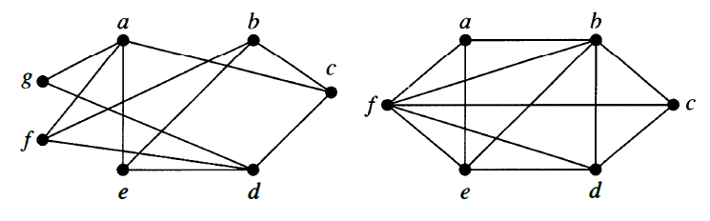
Example 11
Are the following graphs bipartite?

Slide 17
Theorem 4
A simple graph is bipartite if and only if it is possible to assign one of two different colors to each vertex of the graph so that no two adjacent vertices are assigned the same color.
Proof: Let G=(V, E) be a bipartite simple graph. Then V = V₁ V₂, where V₁ and V₂ are two disjoint sets and every edge in E connects a vertex in V₁ and a vertex in V₂. If we assign one color to each vertex in V₁ and a second color to each vertex in V₂, no two adjacent vertices are assigned the same color.

Slide 18
Theorem 4
Now suppose that it is possible to assign colors to the vertices of the graph using just two colors so that no two adjacent vertices are assigned the same color. Let V₁ be the set of vertices assigned one color and V₂ be the set of vertices assigned the other color. Then V₁ and V₂ are disjoint and V = V₁ V₂. Furthermore, every edge connects a vertex in V1 and a vertex in V₂ because no two adjacent vertices are either both in V₁ or both in V₂. Consequently, G is bipartite.

Slide 19
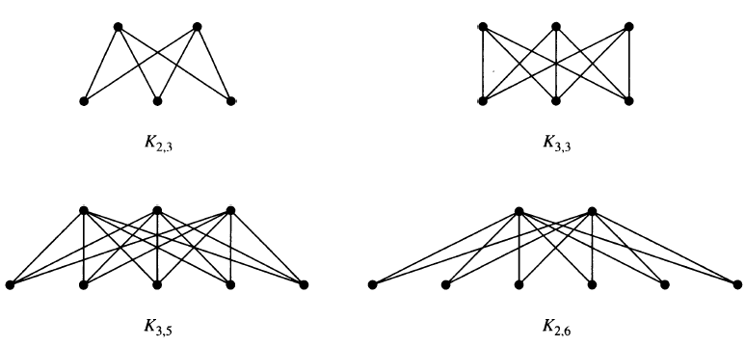
Complete Bipartite Graph
The complete bipartite graph K_{m,n} is the graph that has its vertex set partitioned into two subsets of m and n vertices respectively. There is an edge between two vertices if and only if one vertex is in the first subset and the other vertex is in the second subset.

Slide 20
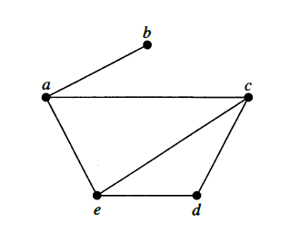
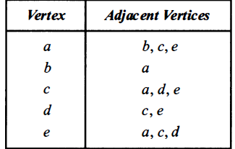
Representing Graphs
Adjacency List:

Slide 21
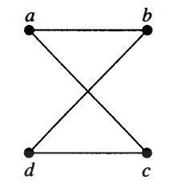
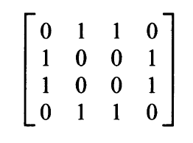
Representing Graphs
Adjacency Matrices:

Slide 22
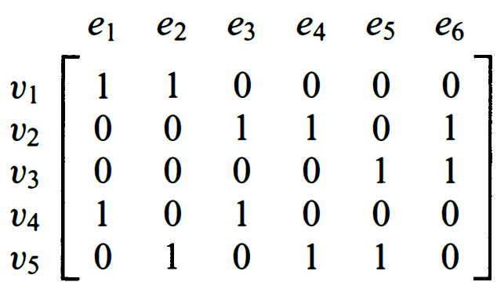
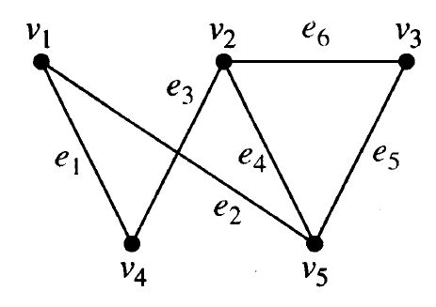
Representing Graphs
Incidence Matrices:

Slide 23
Isomorphism of Graphs
The simple graphs G₁ = (V₁, E₁) and G₂ = (V₂, E₂) are isomorphic if there is a one-to-one and onto function f from V₁ to V₂ with the property that a and b are adjacent in G₁ if and only if f(a) and f(b) are adjacent in G₂, for all a and b in V₁. Such a function f is called an isomorphism.

Slide 24
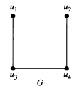
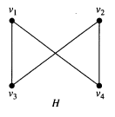
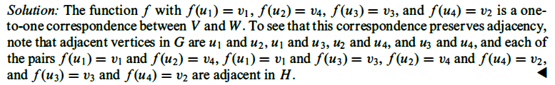
Example 8
Show that the graphs G=(V, E) and H=(W, F) are isomorphic

